Slide 1
Analysis of Adverse Effects of Tramal and Lyrica
FAERS Oct - Dec 2024 Dataset Insights

Slide 2
Introduction 3
Methodology 4
Most Common Adverse Effects of Tramal 5
Comparing Tramal & Lyrica Adverse Effects 6
Key Observations 7
Further Investigation 8
Conclusion 9
A
G
E
N
D
A

Slide 3
Introduction
Objective:
Investigate the most common adverse effects of Tramal using FAERS 2024 data.
Compare Tramal’s adverse effects to Lyrica (another neurological pain medication).
Provide insights on further investigations needed for drug comparison.

Slide 4
Methodology
FAERS Dataset Overview:
FAERS (FDA Adverse Event Reporting System) collects drug safety data.
Data is quarterly, so we combined all four 2019 datasets.
Merged datasets to extract adverse reactions for Tramal and Lyrica.
Data Processing Steps:
Downloaded FAERS 2019 data (Q1–Q4).
Merged the quarterly datasets into one.
Filtered reports mentioning Tramal and Lyrica.
Extracted reaction terms to identify common adverse effects.
Used R to clean and visualize data.

Slide 5
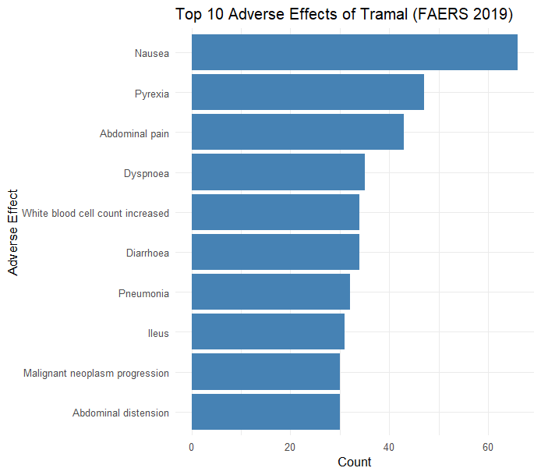
Most Common Adverse Effects of Tramal

Slide 6
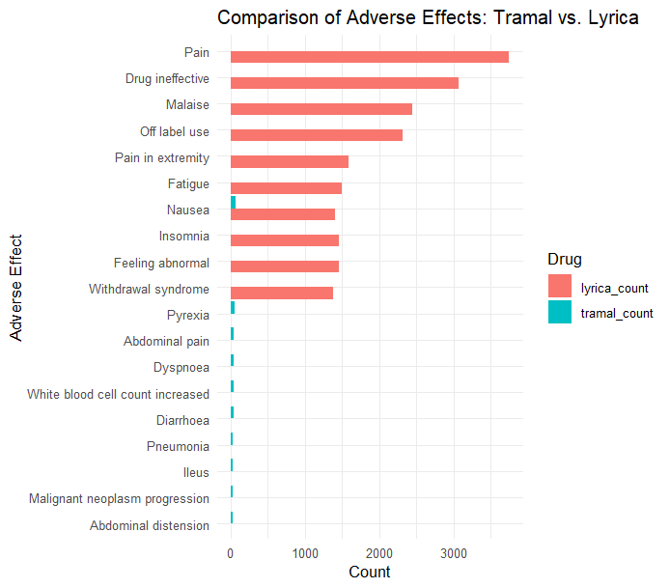
Comparing Tramal & Lyrica Adverse Effects

Slide 7
Key Observations
Lyrica has significantly more reported adverse effects compared to Tramal.
The top reported for Lyrica effects, are Pain, Drug Ineffective, and Malaise.
Tramal has fewer reported adverse effects in FAERS.
The only noticeable adverse effects for Tramal include Nausea, Pyrexia, Dyspnoea, and Abdominal Pain, all with much lower counts.
Overlapping adverse effects include:
Nausea appears in both drugs, though more frequently in Lyrica cases.
Lyrica is associated with serious and unique effects.
Malignant neoplasm progression (cancer worsening) and ileus (intestinal blockage) are reported for Lyrica but not for Tramal.

Slide 8
Further Investigations
What else should we analyze?
Effect Severity:
Do these effects require hospitalization?
Demographic Influence:
Do certain age groups experience more severe reactions?
Drug Interactions:
Are side effects amplified by other medications?
Long-Term Safety:
How do these drugs impact patients over several years?

Slide 9
Conclusion
Summary of Findings:
Lyrica shows a broader range of adverse effects compared to Tramal, with higher case reports in FAERS.
Shared effects like nausea, insomnia, and fatigue suggest some common neurological side effects.
Tramal appears to have fewer recorded cases, but both medications require careful monitoring, especially for withdrawal risks.
Recommendations:
Recommend further clinical studies for long-term safety.
Suggest patient profiling for better drug prescription.
Encourage data-driven monitoring for ongoing safety assessments.

Slide 10
THANK YOU

